Slide 1
The Search for Energy-Efficient Building Blocks for the Data Center
Laura Keys,
Suzanne Rivoire, and
John D. Davis
john.d@microsoft.com
Researcher, Microsoft Research Silicon Valley

Slide 2
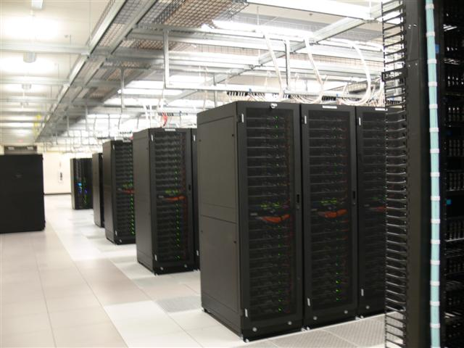
Data Center Energy Cost
  Facility: ~$200M for 15MW facility (15-year amort.)
  Servers: ~$2k/each, roughly 50,000 (3-year amort.)
  Average server power draw at 30% utilization: 80%
  Commercial Power: ~$0.07/KWhr
  Observations:
    $2.3M/month from charges functionally related to power
    Power related costs trending flat or up while server costs trending down
    Details at: http://perspectives.mvdirona.com/2008/11/28/CostOfPowerInLargeScaleDataCenters.aspx
    Courtesy: James Hamilton, ISCA 2009

Slide 3
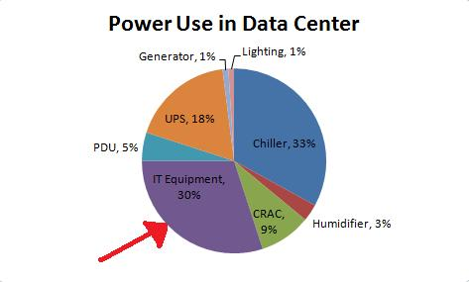
Energy Efficient Data Centers
Decreasing Power Usage Effectiveness (PUE)
  Non-IT equipment being handled more efficiently
  Energy-efficiency in DC now depends on HW and SW being run!
Reduce Waste
Data for pie chart from http://www.42u.com/green-data-center.htm

Slide 4
Research Landscape
Trend: low-end processors + SSDs for energy efficiency
  FAWN (embedded, desktop, server)
  Amdahl Blades (embedded, server)
  CEMS (desktop)
No systematic comparison across all processor classes
Usually focused on a single benchmark

Slide 5
Paper Summary
Compare 4 system classes
  Embedded, mobile, desktop, and server
On single-machine and cluster workloads
  Different mixes of processor, memory, I/O
Goal: understand where each system class is best and where it falls short

Slide 6
Outline
Motivation
Hardware systems
Benchmarks
Results
  Single machine
  5-node clusters
Caveats
Conclusions

Slide 7
Hardware Systems
System Under Test | CPU | Memory | Disk(s) | System Information | Approx. cost
1A (embedded) | Intel Atom N230, 1-core, 1.6 GHz, 4W TDP | 4 GB DDR2-800 | 1 SSD | Acer AspireRevo | $600
1B (embedded) | Intel Atom N330, 2-core, 1.6 GHz, 8W TDP | 4 GB DDR2-800 | 1 SSD | Zotac IONITX-A-U | $600
1C (embedded) | Via Nano U2250, 1-core, 1.6 GHz | 2.37 GB DDR2-800* | 1 SSD | Via VX855 | sample
1D (embedded) | Via Nano L2200, 1-core, 1.6 GHz | 2.86 GB DDR2-800* | 1 SSD | Via CN896/VT8237S | sample
2 (mobile) | Intel Core2 Duo, 2-core, 2.26 GHz, 25W TDP | 4 GB DDR3-1066 | 1 SSD | Mac Mini | $1200
3 (desktop) | AMD Athlon, 2-core, 2.2 GHz, 65W TDP | 8 GB DDR2-800 | 1 SSD | MSI AA-780E | sample
4 (server) | AMD Opteron, 4-core, 2.0 GHz, 50W TDP | 32 GB DDR2-800 | 2 10K RPM | Supermicro AS-1021M-T2+B | $1900

Slide 8
Benchmarks
Single Machine
  CPUEater
  SPEC CPU2006 Integer
  SPEC Power 2008
  JouleSort
5-node Cluster (DryadLINQ)
  Sort
  StaticRank
  Prime
  WordCount

Slide 9
Results

Slide 10
System power
Chipset power dominates embedded system power

Slide 11
Spec CPU 2006 Integer
Normalized per core performance
Core 2 Duo on par or exceeds server cores

Slide 12
Spec Power 2008

Slide 13
Single Machine Summary
Chipset power is the limiting factor for embedded systems
High-end mobile cores have the right mix of power and performance
Desktop cores not competitive from total system power perspective
Server system becoming more efficient
Cluster investigation → High-end mobile, Server & embedded

Slide 14
Cluster Energy Efficiency

Slide 15
Caveats
Limited by real mobile/embedded HW
  Memory: no ECC, limited capacity
  I/O: limited ports and bandwidth
  Chipset/other components: not energy-efficient, dominate system power
Cluster benchmarks scaled for small systems
  Increased task overhead on servers
  Main memory over provisioned on servers

Slide 16
Conclusions
Can improve energy-efficiency by 2-4X
Almost no performance degradation (QoS)
Ideal machine can do better
  High-end mobile processor
  Large capacity ECC-protected DRAM
  Low-power chipset
  More I/O ports and higher bandwidth

Slide 17

© 2007 Microsoft Corporation. All rights reserved. Microsoft, Windows, Windows Vista and other product names are or may be registered trademarks and/or trademarks in the U.S. and/or other countries.
The information herein is for informational purposes only and represents the current view of Microsoft Corporation as of the date of this presentation. Because Microsoft must respond to changing market conditions, it should not be interpreted to be a commitment on the part of Microsoft, and Microsoft cannot guarantee the accuracy of any information provided after the date of this presentation.
MICROSOFT MAKES NO WARRANTIES, EXPRESS, IMPLIED OR STATUTORY, AS TO THE INFORMATION IN THIS PRESENTATION.

Slide 18
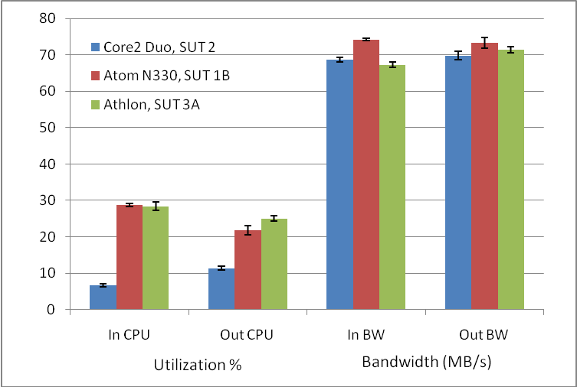
Processor vs. I/O Subsystem

